Slide 1
RESUME SKILLS RECOMMENDER
18R11A05E9, 18R11A05F0,19R15A0519

Slide 2
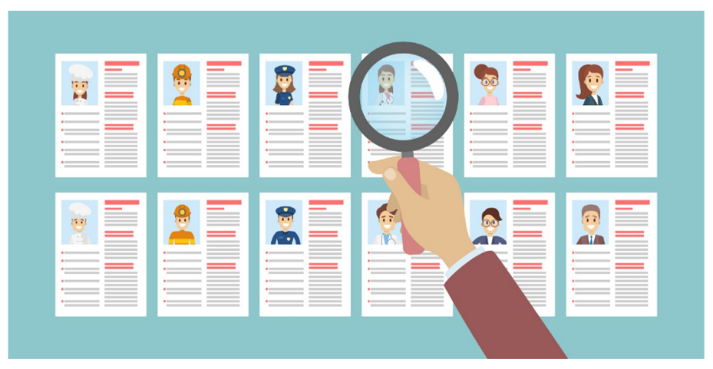
Problem Statement
Nowadays different IT-related job types in demand ,it is hard for a fresh graduate or multi-skilled professional to determine where they would fit best.
The problem is most apparent in today’s data-driven economy, where the job descriptions and roles are closely connected and often overlapping.

Slide 3
Problem Statement
Our project helps in determining what type of IT-related job would be the most suitable (in terms of skill-matching and job competence) for an IT professional, based on a text description that he might provide in his resume or cover letter.
Example : The roles of the Data Scientist, Business Analyst, and Data Engineer
We are interested in determining what type of IT-related job would be the most suitable (in terms of skill-matching and job competence) for an IT professional, based on a text description that he might provide in his resume or cover letter.

Slide 4
Abstract
Candidates apply in large numbers for jobs on web portals by uploading their resumes, due to the rapid growth of online-based recruitment systems.
On the other hand, the resume has its formatting style, data blocks, and segments, as well as a variety of data formatting options such as text alignment, color, font type, and font size, making it an excellent example of unstructured data. As a result, filtering applicants for the appropriate position in an organization becomes a difficult task for recruiters.

Slide 5
Abstract
We use Natural Language Processing (NLP) techniques to extract the relevant information from the resume to save time and effort. Also, a Machine Learning (ML) model is trained to check whether a candidate’s skills, experiences, and other aspects are suitable for that particular role and recommends skills required.
In addition to that, our system will also predict what is the probability of getting shortlisted based on candidate’s skillset.

Slide 6
Objective
The main objective of this project is to recommend skills for resume based on the job description provided by the recruiter.
The model takes the features extracted from the candidate’s resume as input and finds their categories, further based on the required job description the categorized resume mapped and recommend the most suitable candidate’s profile to HR.

Slide 7
Proposed System
Our system extracts the necessary information such as experience, skills, education present in the resume by using certain Natural Language Processing (NLP) techniques.
The extracted information is used to train the machine learning models. The trained model specifies whether the particular candidate has specific skills and recommends skills
Also tells If he/she will be qualified or not in percentage, then the system will recommend other suitable roles for that candidate

Slide 8
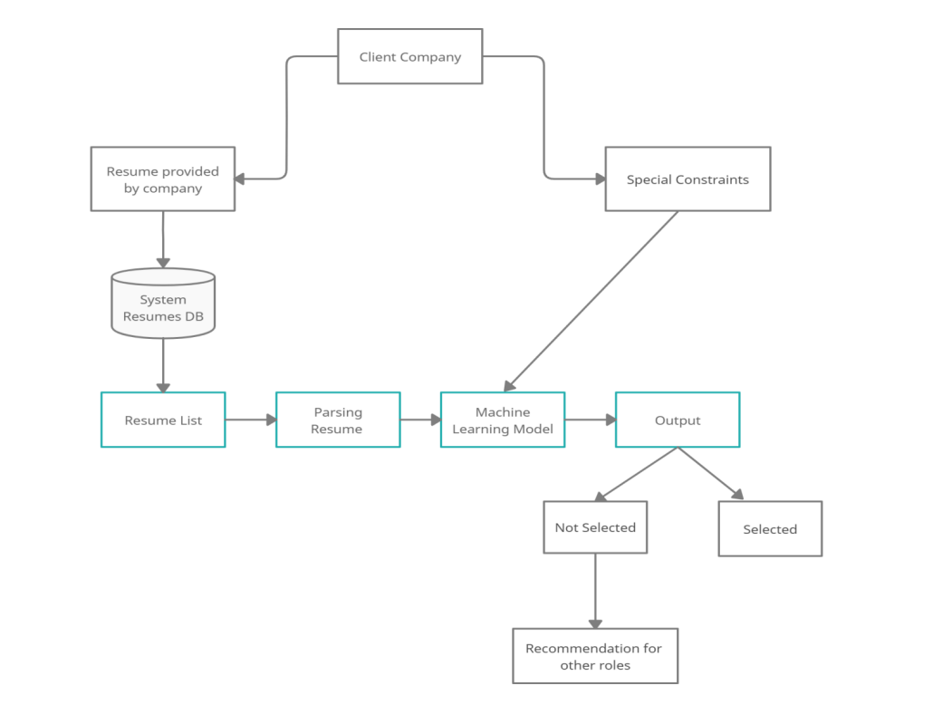
Work Flow of the Proposed System

Slide 9
Modules
Resume Module – functionalities of resume
Skills Module – Set of all the skills required
Job Module – List of Jobs available and management
User Module – Operations related to User

Slide 10
Technologies
Python
Matplotlib
Numpy
Seaborn
Word Cloud
Beautiful Soup
nltk

Slide 11
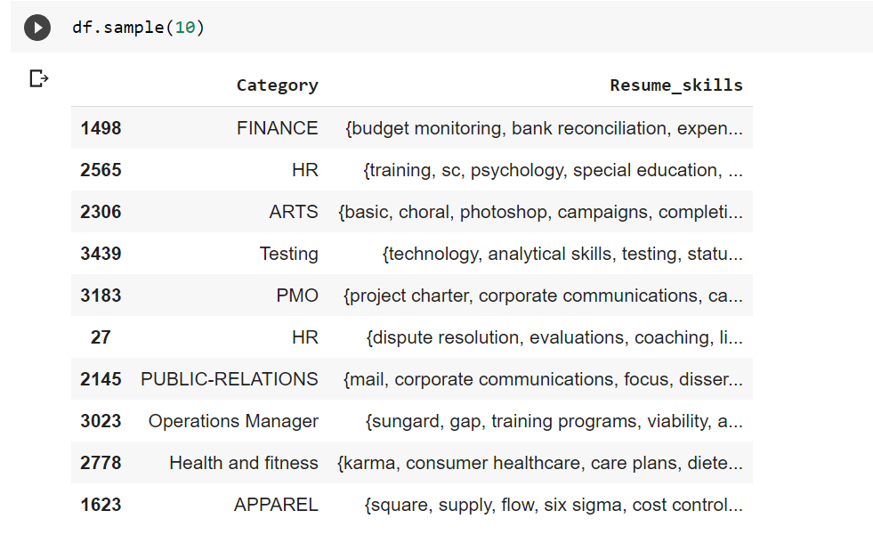
Design Approach
1. Data Collection & Simple EDA
The dataset is taken from Kaggle and linkedIn job portal collected in recent period

Slide 12

Design Approach
2. Text Preprocessing
Text preprocessing is the practice of cleaning and preparing text data. Using NLTK, resumes and job description are then pre-processed with the following:
stop words removal
part-of-speech tagging
lemmatization
alpha characters only

Slide 13
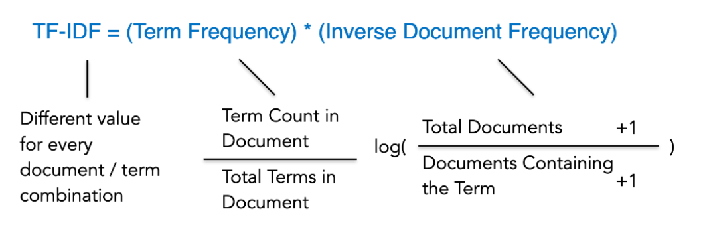
Design Approach
3. Vectorizer
Count Vectorizer concludes that resumes mentioning these “popular” words are more similar with each other
TF-IDF places more weight on rare words. Words that aren’t mentioned across all resumes, but only included in these two resumes — indicating that these documents may be more similar with each other than the rest.er as it puts more emphasis on these popular words

Slide 14
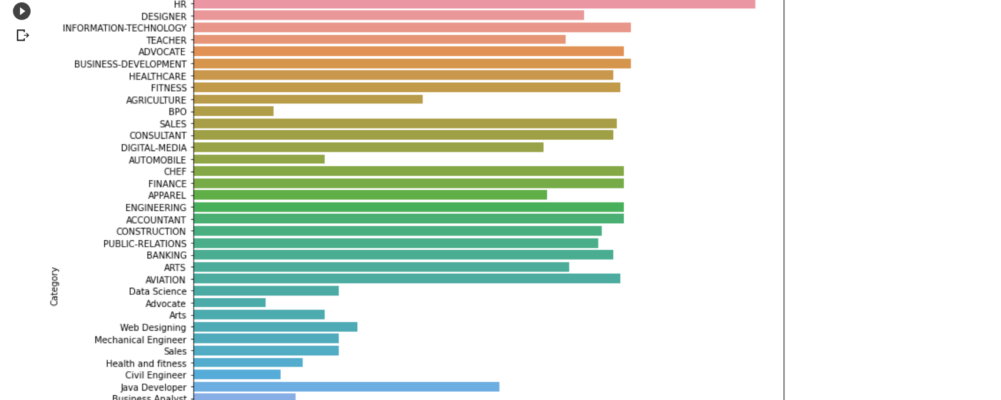
Design Approach
4. Topic Modeling (Dimension Reduction)
This is used to gauge the appropriate number of topics derived from the resumes, number of grams/terms and minimum number of documents containing the grams/terms.

Slide 15
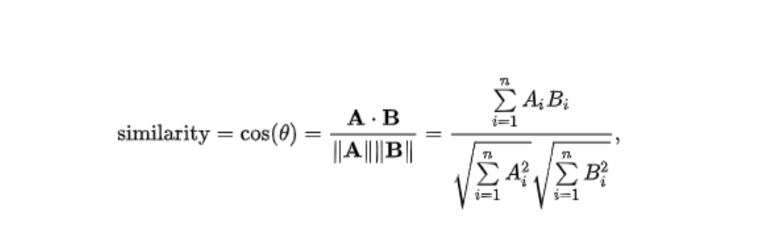
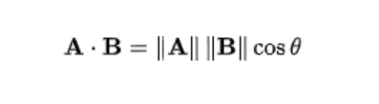
Design Approach
5. Recommendation System Based on Cosine Similarity
Cosine similarity is the cosine of the angle between two vectors, which determines whether two vectors are pointing roughly in the same direction.
Dot product is the product of Euclidean magnitudes of two vectors and the cosine of the angle between them. Other than term occurrence, the frequency of terms showing up in the resume would also bump up the matching.

Slide 16
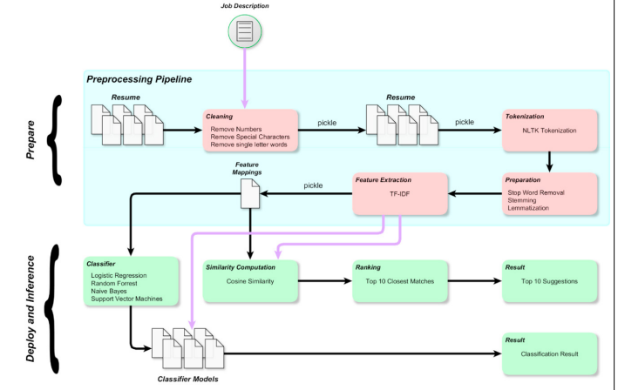
Flow Diagram

Slide 17
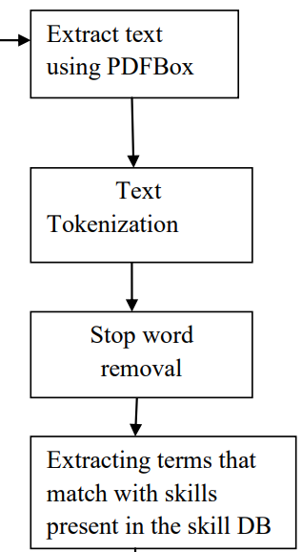
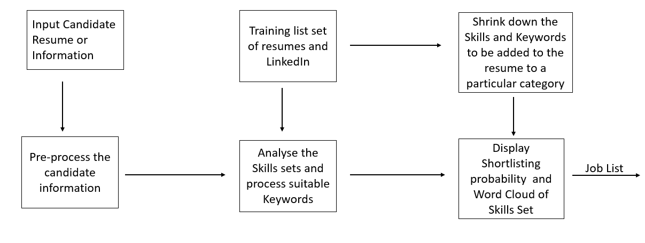
UML Diagrams

Slide 18
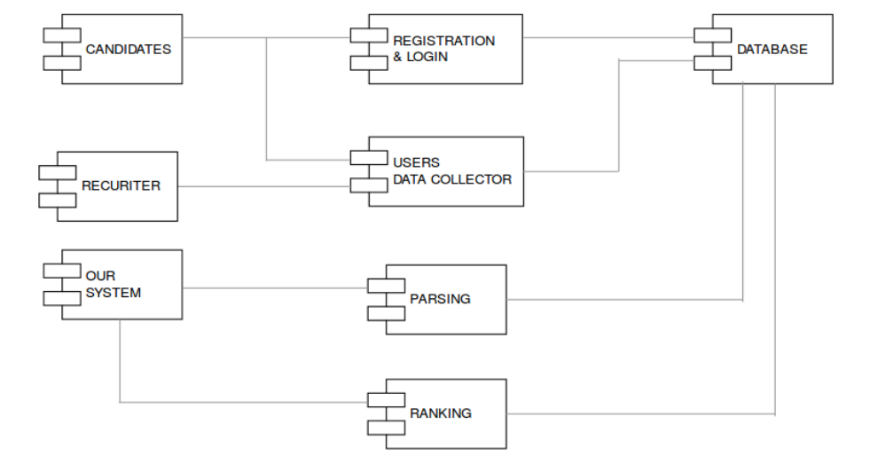
UML Diagrams

Slide 19
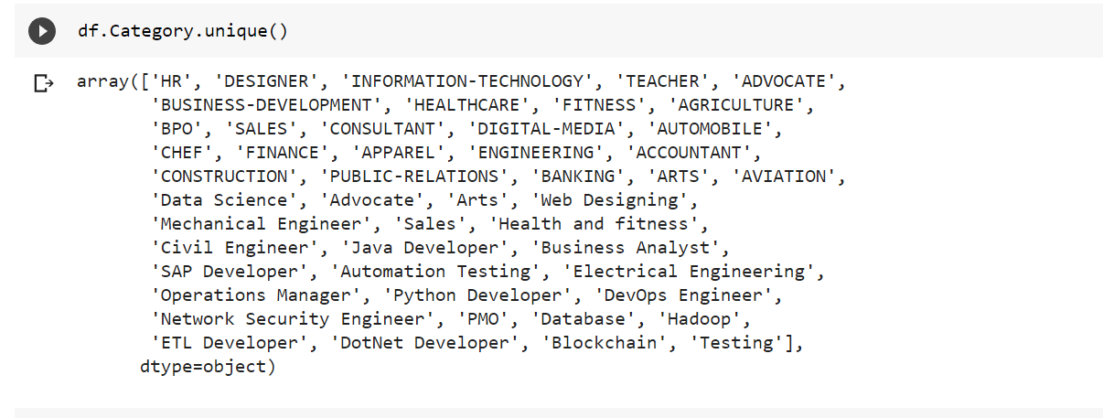
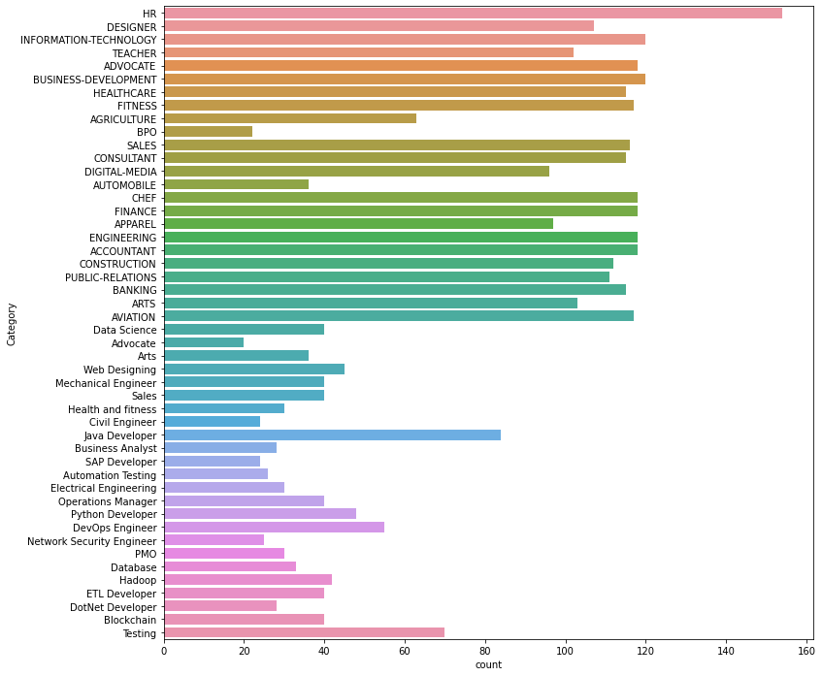
Screenshots

Slide 20
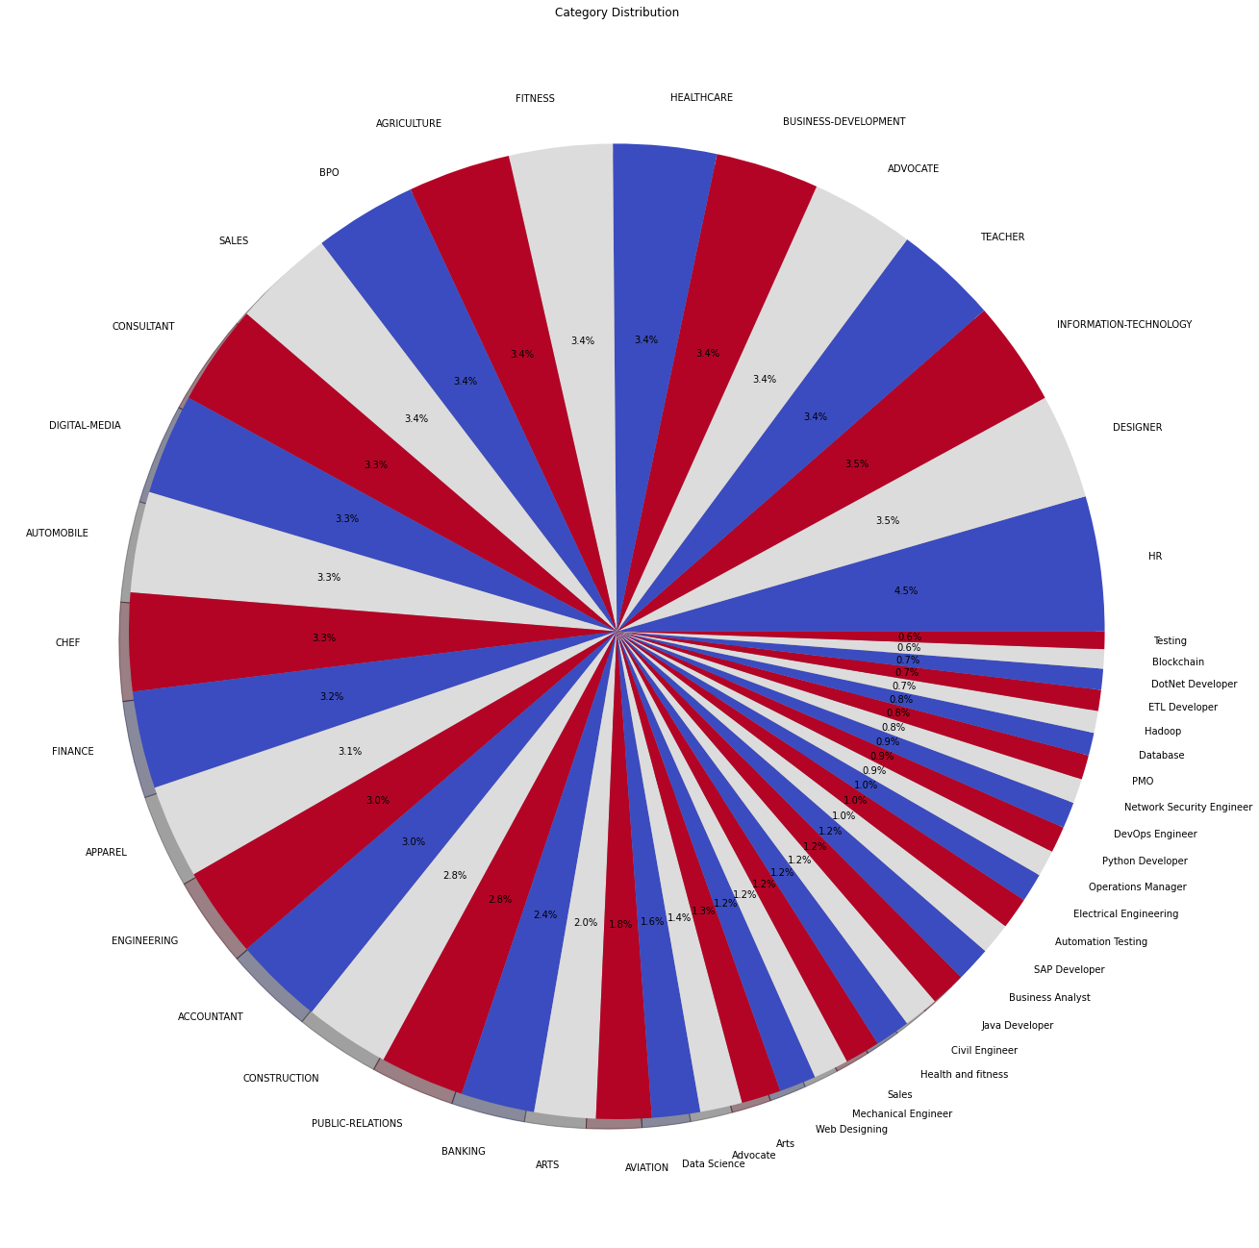
Screenshots

Slide 21
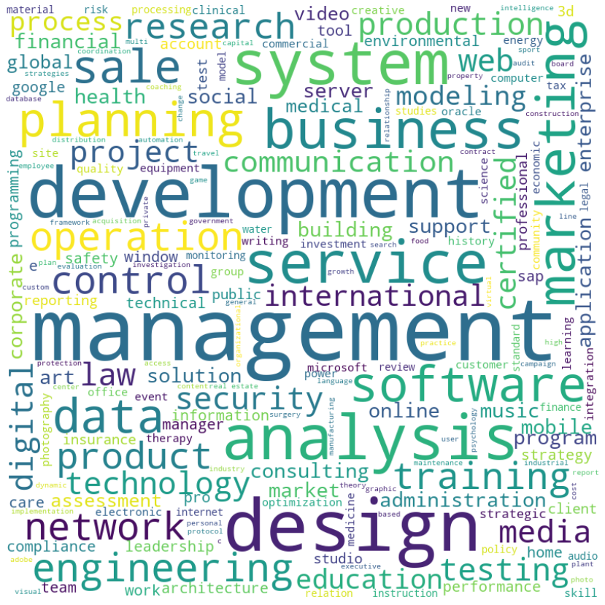
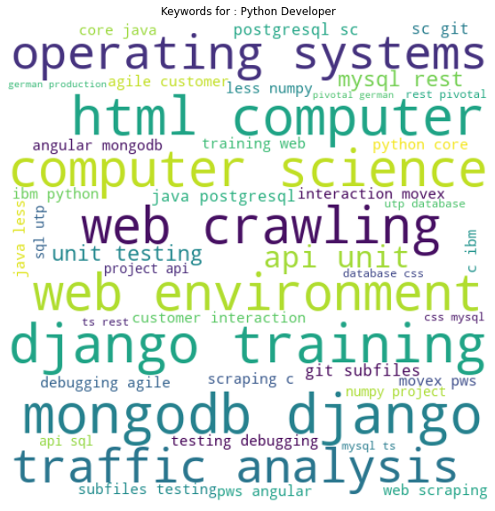
Screenshots

Slide 22
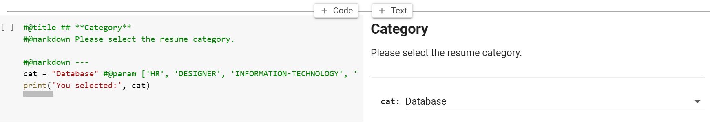
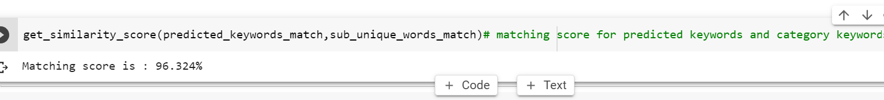
Screenshots

Slide 23
Conclusion
The proposed model worked in two phases: first, classify the resume into different categories. Second, recommends resume based on the similarity index with the given job description.
The proposed approach effectively captures the resume insights, their semantics and yields a good accuracy

Slide 24
Future Enhancements
Obtain company data
Model on text data on one job category or role at a time.
Work with Recruiters to apply supervised learning techniques
Work with Engineering to apply a user feedback loop

Slide 25
Thank You

